Slide 1
Lesson 1
Web Applications, Web Services & Service oriented Architecture

Slide 2
Session Learning Outcomes
At the end of this Topic, the learner should be able to:
Define the term web application
Differentiate between web 1, web 2and web 3
Explain the principles of web services and service oriented architecture
Describe the principles of REST as applied in web application design

Slide 3
History of the Internet & the Web
Started in 1969 as the Advanced Research Projects Agency (ARPA) working for the US department of defense.
Developed ARPANET (Advanced Research Projects Agency Network).
ARPANET used NCP (Network Control Protocol) and originally connected US research centers and universities.

Slide 4
History(Web & Internet)
Later expanded to include other government sectors, more universities, and international hosts (Wikipedia 2016).
Changed from NCP to TCP/IP internet protocol in 1981,, effectively changing ARPANET to The Internet.
This allowed any computer that supported this protocol to be networked together.

Slide 5

Tim Berners Lee
This led to Tim Berners Lee to conceive the world wide web (WWW), and he went on to create the first web site running on the first web server in 1990.
The earliest web featured static web sites which could be viewed on a web browser that supported the early HTML specification.

Slide 6
Web 1.0
The first iteration of the web represents the web 1.0, which, according to Berners-Lee, is the “read-only web.”
In other words, the early web allowed us to search for information and read it.
There was very little in the way of user interaction or content generation.
An example might be a personal Web page that gives information about the site's owner, but never changes

Slide 7
Web 2.0
Then Web 2.0 came in.
Tim referred to it as the “read-write” web.
Users are no longer just consumers; they become producers or co-producers of contents.
Examples include Wikipedia, blogs, social networks and YouTube

Slide 8
Web 3.0
Combines the virtues of Web 1.0 and 2.0.
Adds machine intelligence.
Also known as the Semantic Web.
An extension of the existing World Wide Web, and it represents an effective means of data representation in the form of a globally linked database.
By supporting the inclusion of semantic content in Web pages, the Semantic Web targets the conversion of the presently available Web of unstructured documents to a Web of information/data.

Slide 9
Web Application Defn.
A Web application (Web app) is an application software that is stored on a remote server and delivered over the Internet through a browser interface.
For a web app to operate, it needs a Web server, application server and a database server.
Web servers manage the requests that come from a client.
Application server completes the requested task.
A database server can be used to store any needed information.

Slide 10
What is a Web Service?
A web service is a generic term for an interoperable machine-to-machine software function that is hosted at a network addressable location.
Has an interface, which hides the implementation details so that it can be used independently of the hardware or software platform on which it is implemented, and independently of the programming language in which it is written.
This independence encourages web service based applications to be loosely coupled, component-oriented, cross-technology implementations.

Slide 11


Example of a Service: Ordering Food in a Chinese Restaurant
You(Client)
Waitress(Service)
Kitchen(Server)
You speak English only
Chef speaks Chinese
only
Speaks a language understood
By both client & Server

Slide 12
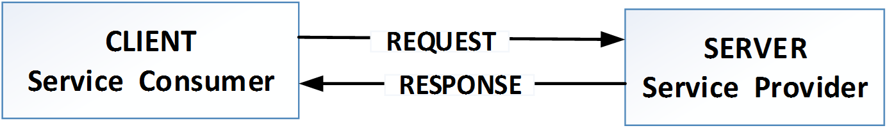
Service Provider & Consumer(cont.)
To enable COMMUNICATION between two applications.
SERVICE PROVIDER-Creator of web services
Develops and implements the application(web service) and makes it available over the internet.
SERVICE CONSUMER-Client

Slide 13
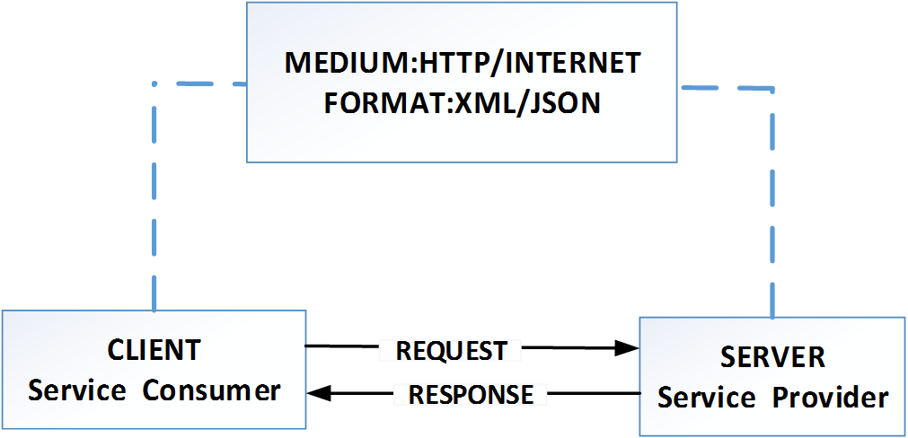
Service Provider & Consumer(cont.)
EXAMPLE: While speaking to your friend over telephone, Medium is the phone and format is the common language(e.g English) that both of you can understand

Slide 14
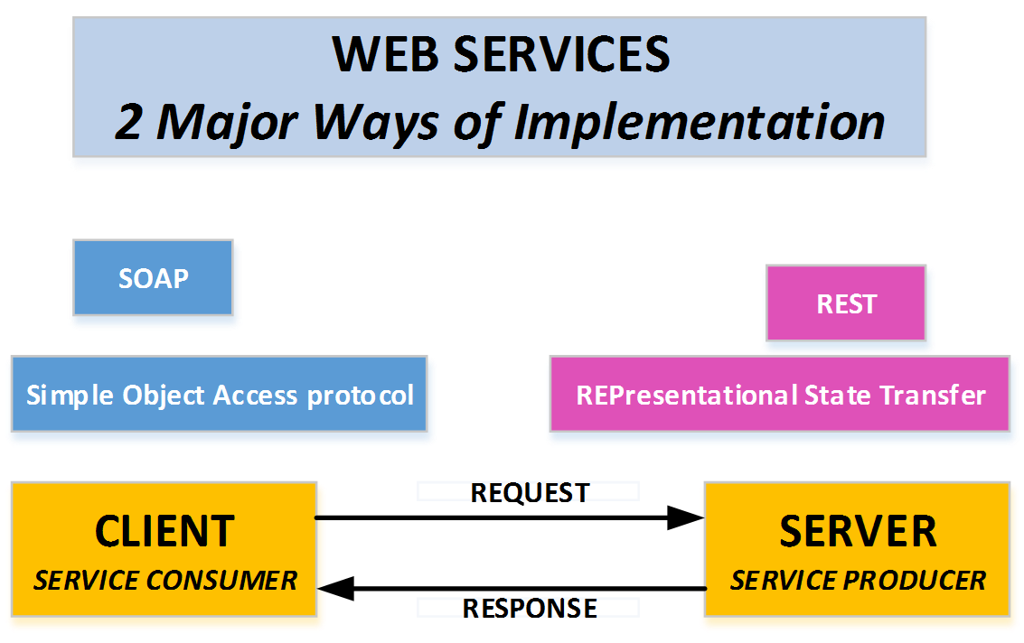
Web Service Implementation Protocols

Slide 15
Web Service Implementation Protocols(cont.)
SOAP:Simple Object Transfer Protocol
Medium:HTTP(POST)
Format: XML
REST:REpresentational State Transfer
Medium:HTTP(POST,GET PUT,DELETE)
Format:XML/JSON

Slide 16
REST
REST is a term coined by Roy Fielding in 2000.
An an acronym for REpresentational State Transfer.
An architecture style for designing loosely coupled applications over HTTP, that is often used in the development of web services.
A web service that communicates/exchanges information between two applications using REST architecture principles is called a RESTful web service.

Slide 17
REST API(cont.)
REST APIs allow you to perform CRUD (create, read, update, and delete) operations between a client and a server.
It connects your backend with your frontend so they can communicate with each other.
Uses HTTP methods like the GET, PUT, POST, and DELETE to request a server perform a particular action.

Slide 18
REST API Principles
REST defines a set of principles/constraints to be followed while designing a service for communication/data exchange between two applications.
When these principles are applied while designing web services(for client-server interactions), we get a RESTful Web Service.
Principles/Constraints.
Client -Server
Uniform interface
Stateless
Cacheable
Layered System

Slide 19
Statelessness
No client context shall be stored on the server between requests. The client is responsible for managing the state of the application.
Statelessness means that every HTTP request happens in complete isolation. When the client makes an HTTP request, it includes all information necessary for the server to fulfill the request.
The server never relies on information from previous requests from the client. If any such information is important then the client will send that as part of the current request.

Slide 20
Advantages of Stateless APIs
Statelessness helps in scaling the APIs to millions of concurrent users by deploying it to multiple servers.
Any server can handle any request because there is no session related dependency.
Being stateless makes REST APIs less complex – by removing all server-side state synchronization logic.
A stateless API is also easy to cache as well
The server never loses track of “where” each client is in the application because the client sends all necessary information with each request.

Slide 21
Client-Server
Both the client and the server are completely autonomous in every way.
Their communication will only happen using the REST API.
This improves the portability of the codebase across multiple platforms and also helps with making the server scalable.
This constraint essentially means that client application and server application MUST be able to evolve separately without any dependency on each other.

Slide 22
Uniform Interface
REST API provides four interfaces to achieve uniformity.
Resource identification
Resource manipulation using representations
Self-descriptive messages
Hypermedia as the engine of application state

Slide 23
Cacheable
Caching is the ability to store copies of frequently accessed data in several places along the request-response path.
REST API is often made cacheable to improve the performance of the application.
It reduces the server load and the client uses the cached response if the user is requesting the same resources.
It also dynamically decreases the load time of your application.

Slide 24
Layered System
The layered system style allows an architecture to be composed of hierarchical layers by constraining component behavior such that each component cannot “see” beyond the immediate layer with which they are interacting.
REST API relies on layered system architecture where applications are allowed to be more stable by limiting the component behavior.
This helps with improving the application security as components in each layer cannot interact beyond the next immediate layer they are in.

Slide 25
What is Software Architecture?
a structured framework used to conceptualize software elements, relationships and properties.
A structure that describes software's major components, their relationships (structures), and how they interact with each other.
A good SA optimizes security, performance and overall quality of software.

Slide 26
Software Architecture Benefits
Serves as a blueprint for a system by providing an abstraction to manage the system complexity.
It defines a structured solution to meet all the technical and operational requirements, while optimizing the common quality attributes like performance and security.
Helps in building a quality, maintainability, performance oriented and the overall success of the final product.

Slide 27
Difference between Architecture & Design.
Software Architecture focuses more on the interaction between the externally visible components of the system where as the Design is about how the internal components of the system interact with each other.
Software Architecture is concerned with issues beyond the data structures and algorithms used in the system

Slide 28
1. Client Server Architecture
Most of the web applications are based on client server architecture.
Client: Client process is requester of the service or information.
Example: Browser, Online chat client, Email client etc.
Server: Server process accepts the request of the client, performs the processing, gathers the required information.
Example: Print server, Web server, Database server, chat server, FTP server etc.
Medium of communication of client and server:
It defines the path by which client and server communicate with each other. E.g.-Internet, Intranet, Bluetooth network etc.

Slide 29
2. Layered/Tiered Architecture
An improvement over the client/server architecture pattern.
Most commonly used architectural pattern.
comprises of three or more layers:
presentation/user interface layer, business logic layer, and data persistence layer.
Uses model view controller (MVC) pattern to simplify web applications
Main advantage is the separation of concerns that is each layer can focus solely on its role and responsibility.

Slide 30
3.Component Based Architecture
Focuses on the decomposition of the design into individual functional or logical components that represent well-defined communication interfaces containing methods, events, and properties.
The primary objective of component-based architecture is to ensure component reusability.
A component encapsulates functionality and behaviors of a software element into a reusable and self-deployable binary unit.
As the software architecture is formulated, components are selected from the library and used to populate the architecture.

Slide 31
4. Service-Oriented Architecture (SOA)
Service-oriented architecture (SOA) is a method of software development that uses software components called services to create business applications.
Each service provides a business capability, and services can also communicate with each other across platforms and languages.
Developers use SOA to reuse services in different systems or combine several independent services to perform complex tasks.
Focuses on having different services communicating with each other to carry out tasks.
Thus, a web service is a basic building block in a SOA.

Slide 32
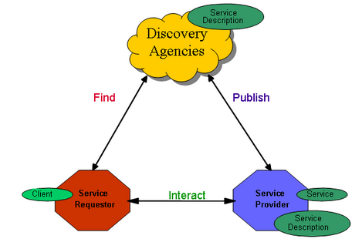
SOA

Slide 33
Micro Services
Micro services, or micro service architecture, is an approach to application development in which a large application is built as a suite of modular components or services.
a service-oriented architecture pattern wherein applications are built as a collection of various smallest independent service units.
MSA focuses on decomposing an application into single-function modules with well-defined interfaces.
These modules can be independently deployed and operated by small teams who own the entire lifecycle of the service.

Slide 34
SOA vs. Microservices
Parameter | SOA | Microservices
Design type | In SOA, software components are exposed to the outer world for usage in the form of services. | Micro Service is a part of SOA. It is an implementation of SOA.
Dependency | Business units are dependent. | They are independent of each other.
Size of the Software | Software size is larger than any conventional software | The size of the Software is always small in Microservices
Technology Stack | The technology stack is lower compared to Microservice. | Microservice technology stack could be very large
Nature of the application | Monolithic in nature | Full stack in nature
Independent and Focus | SOA applications are built to perform multiple business tasks. | They are built to perform a single business task.
Deployment | The deployment process is time- consuming. | Deployment is straightforward and less time-consuming.
Cost - effectiveness | More cost-effective. | Less cost-effective.
Scalability | Less compared to Microservices. | Highly scalable.
Business logic | Business logic components are stored inside of single service domain Simple wire protocols(HTTP with XML JSON) API is driven with SDKs/Clients | Business logic can live across domains enterprise Service Bus like layers between services Middleware

Slide 35
The end Thank you

